Slide 1


Binary Search Trees
Dictionary Operations:
  IsEmpty()
  Search(key)
  Insert(key, value)
  Delete(key)

Slide 2
Definition of Binary Search Tree
A binary tree.
Each node has a (key, value) pair.
For every node x, all keys in the left subtree of x are smaller than that in x.
For every node x, all keys in the right subtree of x are greater than that in x.

Slide 3
Example Binary Search Tree
20
10
40
6
15
30
2
8
25
Only keys are shown.

Slide 4
The Operation Ascend()
20
10
40
6
15
30
2
8
25
Do an inorder traversal. O(n) time.
Notes:
Ascend is not a standard dictionary operation. It outputs in sorted order.

Slide 5
The Operation Search()
20
10
40
6
15
30
2
8
25
Complexity is O(height) = O(n), where n is number of nodes/elements.

Slide 6
The Operation Insert()
20
10
40
6
15
30
2
8
25
35
Insert a pair whose key is 35.

Slide 7
The Operation Insert()
20
10
40
6
15
30
2
8
25
35
7
Insert a pair whose key is 7.

Slide 8
The Operation Insert()
20
10
40
6
15
30
18
25
35
2
8
7
Insert a pair whose key is 18.

Slide 9
The Operation Insert()
20
10
40
6
15
30
18
25
35
2
8
7
Complexity of Insert() is O(height).

Slide 10
The Operation Delete()
Four cases:
  No element with delete key.
  Element is in a leaf.
  Element is in a degree 1 node.
  Element is in a degree 2 node.
Notes:
Case 1, either do nothing or report an error.

Slide 11
Delete from a Leaf
20
10
40
6
15
30
18
25
35
2
8
7
Delete a leaf element. key = 7

Slide 12
Delete from a Leaf (contd.)
20
10
40
6
15
30
18
25
35
2
8
7
Delete a leaf element. key = 35

Slide 13
Delete from a Degree 1 Node
20
10
40
6
15
30
18
25
35
2
8
7
Delete from a degree 1 node. key = 40

Slide 14
Delete from a Degree 1 Node (contd.)
20
10
40
6
15
30
18
25
35
2
8
7
Delete from a degree 1 node. key = 15

Slide 15
Delete from a Degree 2 Node
20
10
40
6
15
30
18
25
35
2
8
7
Delete from a degree 2 node. key = 10

Slide 16
Delete from a Degree 2 Node
20
10
40
6
15
30
18
25
35
2
8
7
Replace with largest key in left subtree (or smallest in right subtree).

Slide 17
Delete from a Degree 2 Node
20
10
40
6
15
30
18
25
35
2
8
7
Replace with largest key in left subtree (or smallest in right subtree).

Slide 18
Delete from a Degree 2 Node
20
8
40
6
15
30
18
25
35
2
8
7
Replace with largest key in left subtree (or smallest in right subtree).

Slide 19
Delete from a Degree 2 Node
20
8
40
6
15
30
18
25
35
2
8
7
Largest key must be in a leaf or degree 1 node.

Slide 20
Another Delete from a Degree 2 Node
20
10
40
6
15
30
18
25
35
2
8
7
Delete from a degree 2 node. key = 20

Slide 21
Delete from a Degree 2 Node
20
10
40
6
15
30
18
25
35
2
8
7
Replace with largest in left subtree.

Slide 22
Delete from a Degree 2 Node
20
10
40
6
15
30
18
25
35
2
8
7
Replace with largest in left subtree.

Slide 23
Delete from a Degree 2 Node
18
10
40
6
15
30
18
25
35
2
8
7
Replace with largest in left subtree.

Slide 24
Delete from a Degree 2 Node
18
10
40
6
15
30
2
8
25
35
7
Complexity is O(height).

Slide 25
Indexed Binary Search Tree
Binary search tree.
Each node has an additional field.
  leftSize = number of nodes in its left subtree

Slide 26
Example Indexed Binary Search Tree
7
20
4
3
10
40
1
0
1
6
15
30
0
0
0
1
0
18
25
35
2
8
0
7
leftSize values are in red

Slide 27
leftSize and Rank
Rank of an element is its position in inorder (inorder = ascending key order).
[2,6,7,8,10,15,18,20,25,30,35,40]
rank(2) = 0
rank(15) = 5
rank(20) = 7
leftSize(x) = rank(x) with respect to elements in subtree rooted at x

Slide 28
leftSize and Rank
7
20
4
3
10
40
1
0
1
6
15
30
0
0
0
1
0
18
25
35
2
8
0
7
sorted list = [2,6,7,8,10,15,18,20,25,30,35,40]

Slide 29
Search(index) and Delete(index)
7
20
4
3
10
40
1
0
1
6
15
30
0
0
0
1
0
18
25
35
2
8
0
7
sorted list = [2,6,7,8,10,15,18,20,25,30,35,40]
Notes:
Search(index) returns the element with the specified index.

Slide 30
Search(index) and Delete(index)
if index = x.leftSize desired element is x.element
if index < x.leftSize desired element is index’th element in left subtree of x
if index > x.leftSize desired element is (index - x.leftSize-1)’th element in right subtree of x

Slide 31
Applications
(Complexities are for Balanced Trees)
Best-fit bin packing in O(n log n) time.
Representing a linear list so that Search(index), Insert(index, element), and Delete(index) run in O(log(list size)) time (uses an indexed binary tree, not indexed binary search tree).
Can’t use hash tables for either of these applications.
Notes:
Best-fit bin packing is described in next lecture.

Slide 32
Linear List as Indexed Binary Tree
7
h
4
3
e
l
1
0
1
b
f
j
0
0
0
1
0
g
i
k
a
d
0
c
list = [a,b,c,d,e,f,g,h,i,j,k,l]
Notes:
List elements are placed in a binary tree so that an inorder traversal of the binary tree visits the elements in list order from left to right.
get() and erase() work as they do in an indexed binary search tree.

Slide 33
Insert(5,’m’)
7
h
4
3
e
l
1
0
1
b
f
j
0
0
0
1
0
g
i
k
a
d
0
c
list = [a,b,c,d,e,f,g,h,i,j,k,l]
Notes:
Insert m so it becomes the list element whose index is 5. First element has index 0.

Slide 34
Insert(5,’m’)
7
h
4
3
e
l
1
0
1
b
f
j
0
0
0
1
0
g
i
k
a
d
0
c
list = [a,b,c,d,e, m,f,g,h,i,j,k,l]
find node with element 4 (e)

Slide 35
Insert(5,’m’)
7
h
4
3
e
l
1
0
1
b
f
j
0
0
0
1
0
g
i
k
a
d
0
c
list = [a,b,c,d,e, m,f,g,h,i,j,k,l]
find node with element 4 (e)

Slide 36
Insert(5,’m’)
7
h
4
3
e
l
1
m
0
1
b
f
j
0
0
0
1
0
g
i
k
a
d
0
c
add m as right child of e; former right subtree of e becomes right subtree of m

Slide 37
Insert(5,’m’)
7
h
4
3
e
l
1
0
1
b
f
j
0
0
0
1
0
m
g
i
k
a
d
0
c
add m as leftmost node in right subtree of e

Slide 38
Insert(5,’m’)
Other possibilities exist.
Must update “some” leftSize values on path from root to new node.
Complexity is O(height).

Slide 39
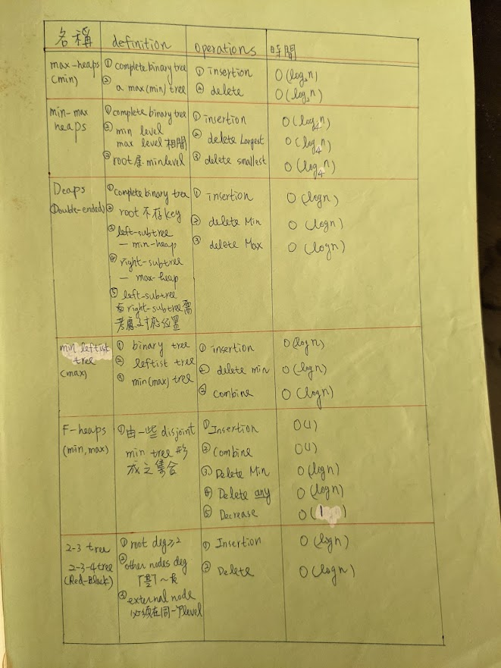
已經講過
已經講過

